Slide 1
Digital Detection
Using Technology To Understand And Respond to Corruption

Slide 2
Technical Leadership Project
Title: A Mixed-Methods Approach to Distinguishing Legitimate, Superficial, and Fabricated Anti-corruption Campaigns
Implementing Partners: CEPPS/IFES, D-ARCH, Internews and UPENN's DevLab. CEPPS/IRI will provide support in administration of subawards.
Relevant DEPP Learning Question: What are the signs that anti-corruption campaigns are being used as a political strategy to target opponents rather than a sincere interest in addressing corruption? (2.2)

Slide 3
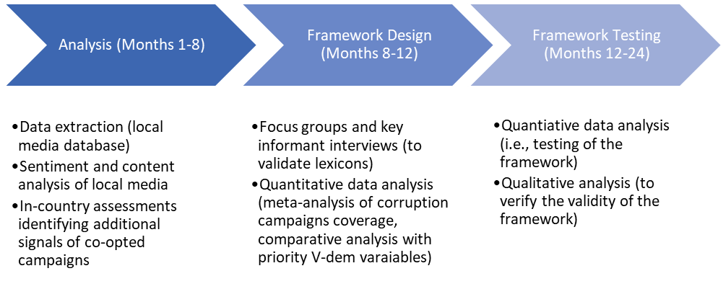
Technical Leadership Project - Process

Slide 4
Identifying Legitimate/Superficial/Fabricated Anticorruption Campaigns
Review of the Machine Learning for Peace (MLP) dataset
Developed by DevLab@Penn, sponsored by USAID, INSPIRES.
Contains newspaper articles for 60 countries since 2012.
Classifies articles according to their content into 20 categories using a RoBERTa-based model.
Sentiment and content analysis of articles about corruption from the MLP dataset
Identify coverage patterns across independent and government media
Identify targets of anti-corruption campaigns
Classify anti-corruption campaigns as “likely legitimate”, “likely superficial”, or “likely fabricated”
In-country assessments to identify messaging modalities beyond traditional media
3 in-country assessments
Focus: billboards, posters, campaign speeches, political advertisements and potential elite signaling

Slide 5
Understanding the Relationship Between Anticorruption Lexicon and Political Change
Literature Review
Anti-Corruption Campaign Messaging Lexicon
Predictive Analysis of Contexts Vulnerable to Anti-Democratic Motives
MLP Content Analysis
V-Forecast Models
In-Country Assessments
Data on Democratic Institutions and Democratic Stability

Slide 6
Guidance, Engagement, Training
Develop guidance for journalists to conduct rhetorical analysis
Co-develop engagement strategy, training package, digital product to encourage media's regular use of analytics in reporting
Community management to enable sustained reporting on motivations driving anti-corruption reporting

Slide 7
Technical Leadership Project - Key Outputs
Literature review
Global anti-corruption campaign messaging lexicon
Datasets and models for anti-corruption language analysis and forecasting
Implementation guide and other training materials for anti-corruption partners

Slide 8
Pilot Project
Title: Effective Approaches to Building Multi-Stakeholder Action Against Transnational Corruption in Elections
Implementing Partners: CEPPS/IFES, CIPE and Brookings Institution. CEPPS/NDI will provide critical support in administrative of subawards.
Relevant DEPP Learning Question: What are effective programming approaches that can be used to activate multi-stakeholder coalitions for addressing transnational corruption? (5.1)

Slide 9
Pilot Project
1. Establishing parameters, typologies and initial assumptions
2. Developing & iteratively applying an Agent Based Model
3. Setting up action plans & evaluation mechanisms with partners
4. Analytically driven engagement, evaluation & adaption of the ABM
5. Final evaluation and dissemination of findings

